Slide 1


M.KUMARASAMY COLLEGE OF ENGINEERING (Affiliated to Anna University)
Department of Electrical and Electronics Engineering
Subject Code : 18EEP302L
Subject Name : Minor Project IV
Academic Year : (2022-2023) – III Year
Batch : (2020-2024)
Date : 29/04/2023

Slide 2
IOT Based Solar Power Monitoring System
BATCH NO: 17
Guided by
Mr. G. Subramaniam
Assistant Professor
Department of EEE
Batch Members:
Ragul P (20BEE4068)
Sabarinathan P (20BEE4073)
Sugadev M (20BEE4095)

Slide 3
Contents
Objective of the Project
Introduction
Block Diagram
Working principle
Circuit Diagram
Components and It’s cost
Applications
Project Outcome
Conclusion

Slide 4
Objective of the Project
The Idea of Designing and Implementation of IoT Based Solar Power Monitoring System using ESP32 Wi-Fi Module.
The ESP32 connects to the Wi-Fi Network and uploads the Solar Sensing parameters like Solar Panel Voltage, Temperature, and Light Intensity on Thingspeak Server.

Slide 5
Introduction
Solar power plants ought to be monitored for optimum power output. This helps retrieve economical power output from power plants whereas watching for faulty star panels, connections, dirt accumulated on panels lowering output and different such problems moving star performance.
Therefore here a tendency to propose machine-driven an automatic IOT based mostly solar energy watching system that enables for automated solar energy watching from anyplace over the web.

Slide 6
Block Diagram
Temperature Sensor
LCD Display
Solar Panel
12v
ESP32
WIFI
module
Voltage Sensor
ThingSpeak
Cloud
Light Sensor

Slide 7
ESP32 WI-FI MODULE :
ESP32 is a series of low-cost, low-power system on a chip microcontrollers with integrated Wi-Fi and dual-mode Bluetooth. In this project it controls the system, monitoring the system and send the data to cloud.
VOLTAFE SENSOR :
The Voltage Sensor is a simple but very useful module that uses a potential divider to reduce an input voltage by a factor of 5. The Voltage Sensor Module allows you to use the analog input of a microcontroller to monitor voltages much higher than it is capable of sensing.

Slide 8
LIGHT SENSOR
LDRs are very different from other forms of resistor like the carbon film resistor, metal oxide film resistor, metal film resistor, and the like that are widely used in other electronic designs. They are specifically designed for their light sensitivity and the change in resistance this causes.
TEMPERATURE SENSOR
The LM35 series are precision integrated-circuit temperature devices with an output voltage linearly proportional to the Centigrade temperature. It has an advantage over linear temperature sensors calibrated in Kelvin, as the user is not required to subtract a large constant voltage from the output to obtain convenient Centigrade scaling.

Slide 9
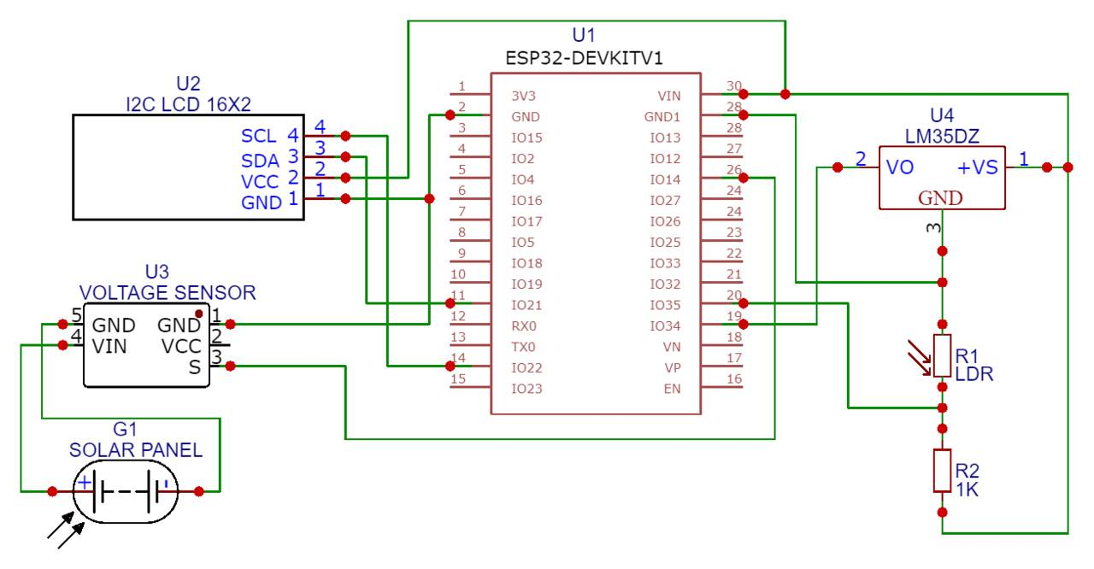
Circuit Diagram

Slide 10
Working Principle
The circuit mainly consists of solar panel, temperature sensor, voltage sensor, light sensor, ESP32 Wi-Fi module, LCD display.
The ESP32 connects to the Wi-Fi Network and uploads the Solar Sensing parameters like Solar Panel Voltage, Temperature, and Light Intensity on Thingspeak Server.
This project allows the monitoring power output of a solar panel, incident light intensity, and the operating temperature using an ESP32 Wi-Fi. The Solar Panel and the sensors are precisely connected to the ESP32 controller which supervises the panels and loads. Thus, users can view the voltage, temperature, and sunlight intensity online from any part of the world.

Slide 11
Components & It’s cost
Components | Quantity | Price (₹)
ESP32 Wi-Fi Module | 1 | 1100
Temperature Sensor | 1 | 120
Voltage Sensor | 1 | 310
Light Sensor | 1 | 180
Solar panel 12V | 1 | 1280
LCD Display | 1 | 290
Jumper wire | 10 | 50
Total = ₹ 3330

Slide 12
Applications
Application of IoT is proving beneficial for monitoring renewable energy generation. This application of IoT uses system based on ESP32 to monitor parameters of the solar panel.
The monitoring system is used in home to monitor the energy generated and energy consumption of devices.
It is also applied in industries to monitor the power.
There are a wide variety of possible uses of this technology, including Solar cities, Smart villages, Microgrids, and Solar street lighting.

Slide 13
Project Outcome
The solar panel is monitored by the system continuously and the power output is transmitted over the internet to the IoT Network.
It now uses an effective Interface to display these solar panel parameters to the user and it also alerts user when the outcome falls underneath the cut-off points specified.
This makes, distantly monitoring of solar power plants more convenient and the best output of power is guaranteed.

Slide 14
Conclusion
Renewable energy source to produce green energy for meeting out our energy consumption. This can help the society to decrease greenhouse gas emission and ozone layer depletion for future generation.
Among this solar photovoltaic technique is gaining popularity due to huge availability, reduced cost, easy installation, and maintenance. Currently, Internet of Things (IoT) is an evolving technology that makes things smarter and user-friendly when connected through the communication protocol and cloud platform.

